Slide 1
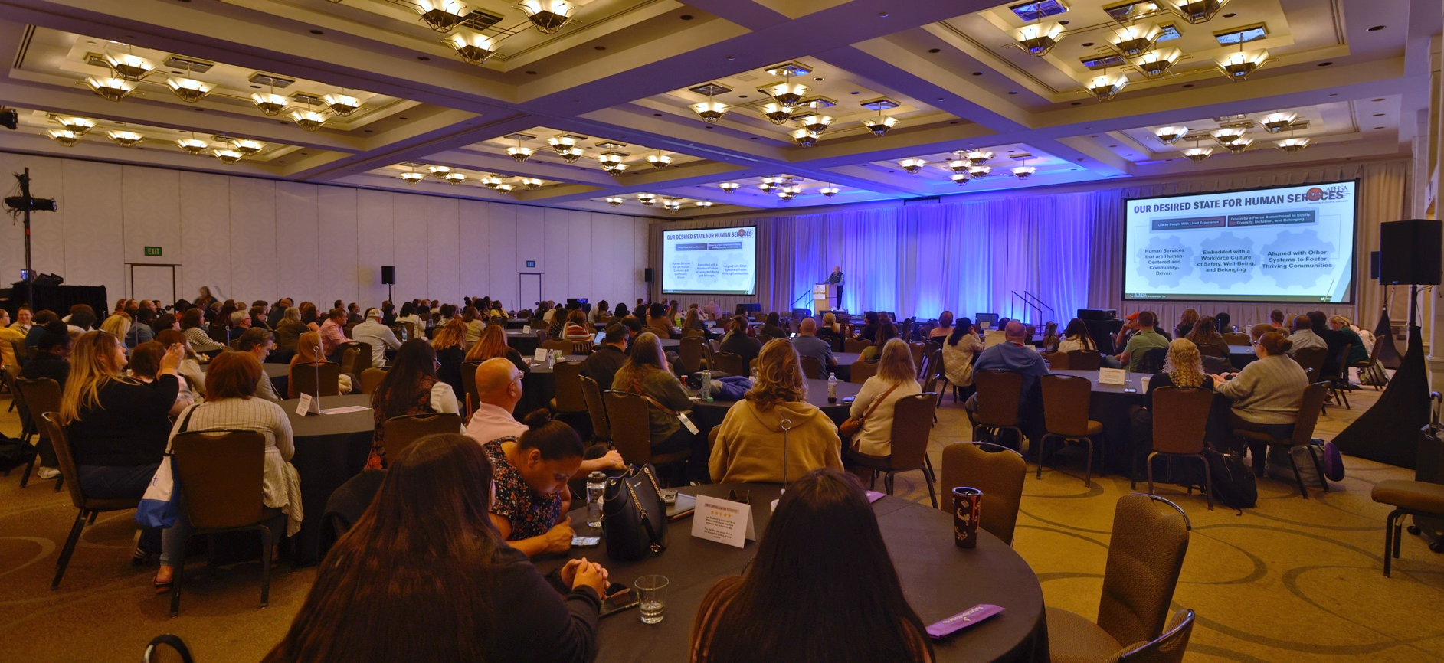

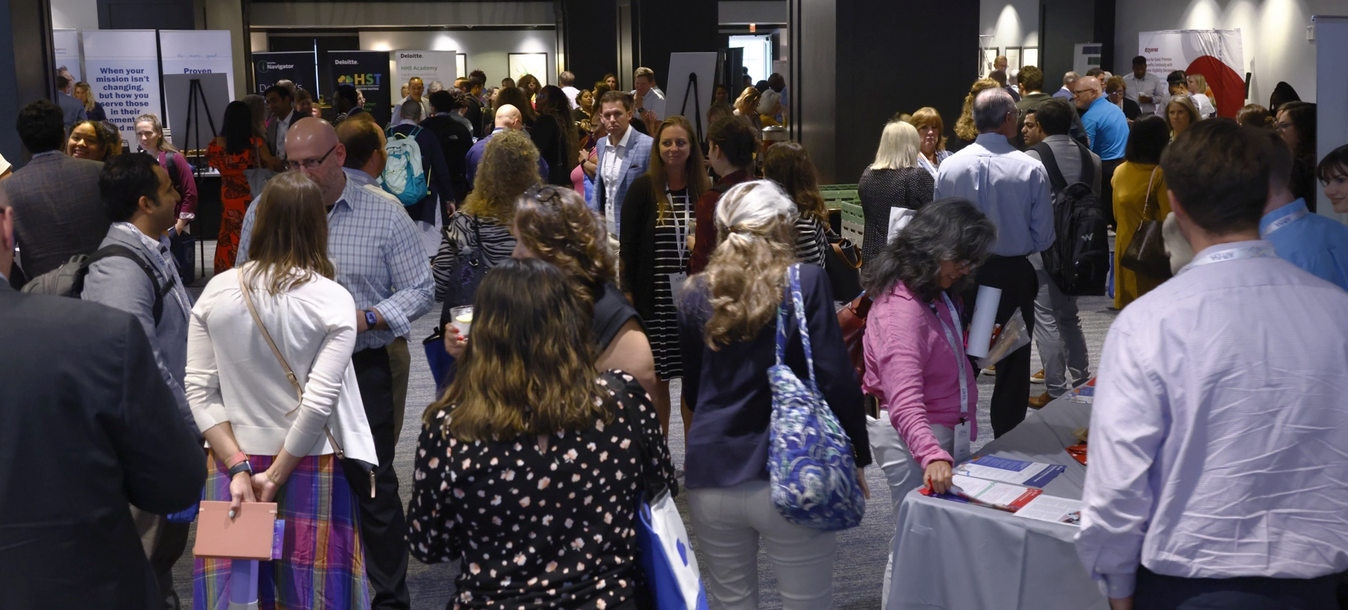



APHSA Event Sponsorship Opportunities
2025
www.APHSA.org
updated 2/3/2025

Slide 2
About APHSA
Who We Are
Our Vision
The American Public Human Services Association (APHSA) supports leaders from state, county, and city human services agencies to advance the well-being of individuals, families, and communities nationwide. As a bipartisan membership association, we work with our members to generate pragmatic solutions grounded in lived experience with a lens for equity and belonging.
APHSA members administer, oversee, and align programs that build resilience and bolster family well-being through access to food, health care, housing, employment, child care, and many other key building blocks necessary for thriving communities. Our members also work to modernize and align human services Information Technology (IT) systems, performance measurement and data analysis, workforce development and training, and the legal dimensions of the sector.
Learn More About APHSA
A nation of thriving communities built on human potential.
Dedicated to public service and the common good, our members build well-being from the ground up so that everyone can thrive.
Our Mission
Influence, Build, Connect
In partnership with our members, we influence modern approaches to sound policy, build the capacity of public agencies to enable healthy families and communities, and connect leaders to accelerate learning and generate practical solutions together.

Slide 3









APHSA Affinity Groups
Members Providing Expertise on Policy, Practice, and Operations
Association of Administration of the Interstate Compact on the Placement of Children (AAICPC)
Establishing uniform legal and administrative procedures governing the interstate placement of children.
American Association of SNAP Directors (AASD)
Providing expert leadership and consultation on Supplemental Nutrition Assistance Program (SNAP) and income assistance issues.
APHSA houses several disciplines in human services, whose members are the administrators operating agency divisions or departments in states and localities throughout the nation and, for the most part, report to a commissioner. The peer affinity groups cover a range of program specializations that also support APHSA functions. Affinity group members support the Association’s policy work by providing critical insight and expertise in their subject area to develop and share detailed policy and practice recommendations.
IT Solutions Management for Human Services (ISM)
Promoting collaboration and innovation in Human Services Information Technology (IT) systems.
National Association of Public Child Welfare Administrators (NAPCWA)
Developing and influencing national policy, strengthening leaders of public child welfare agencies, advancing innovative practices on improving resilience and protective factors, promoting healthy child development, and strengthening communities.
National Association for Program Information and Performance Measurement (NAPIPM)
Achieving better outcomes for children, families, and communities by strengthening program integrity, accountability, data analysis, and measurement.
National Association of State Child Care Administrators (NASCCA)
Advancing federal, state, and local policies and programs that improve access to and quality of child care and support families in today’s rapidly changing environment.
National Association of State Temporary Assistance for Needy Families (TANF) Administrators (NASTA)
Helping families obtain temporary cash assistance and skills for gainful employment leading to self-sufficiency.
National Staff Development and Training Association (NSDTA)
Improving the well-being of children, families, and communities through staff and organizational development innovations.
Public Human Services Attorneys (PHSA)
Facilitating the exchange of information between government attorneys to promote collaboration and innovation in representing agencies administering legal human services.

Slide 4
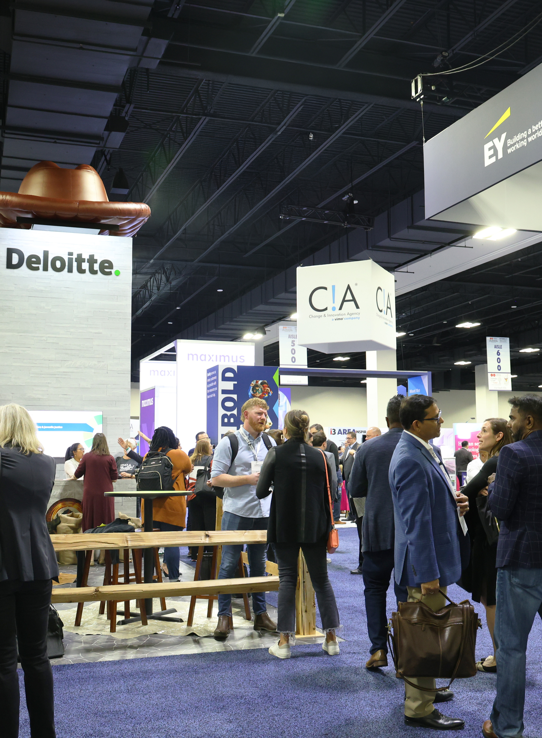

Welcome, Partners!
Sponsoring the American Public Human Services Association (APHSA) educational conferences allows you to position your company as a leader in the human services field, establish relationships with policymakers, deepen current customer relationships, educate state and local human services leaders about your solutions, and learn about challenges and priorities from APHSA member organizations.
These conferences are specifically designed to provide strategic thinking,
real-world examples of innovation, best practices, and emerging technologies to help attendees learn more about improved service delivery, state, local and federal policy, and innovative and transformational trends in human services.
Don’t wait—secure an opportunity today to reach the top human service leaders. From the agency executives and deputies to program directors/analysts and beyond, your sponsorship will give you exposure to these valuable in-person events throughout the year!
Meeting Safely: APHSA remains committed to the safety and well-being of attendees at our in-person events as our top priority. We strongly encourage all who attend APHSA events to be up to date on their COVID-19 vaccinations, as defined by the CDC, and monitor their well-being at the time of the meeting. Masks are welcome but not required. This policy can change based on local jurisdiction protocols.

Slide 5

Who Attends & Why Support
Typical Attendees at APHSA Events
Reasons to Become a Sponsor in 2025
Senior Staff
Deputy or Deputy Director,
Associate Commissioner, Chief of Staff, Chief Executive Officers, Chief Technology Officers, and Other C-Suite Positions
Managerial or Supervisory Staff
Program Administrators or Managers
Project Managers, Performance Management/Quality Control
Consultants and Non-Profit Executives
According to the Center for Exhibition Industry Research, there are several benefits to company sponsorship and exhibitions at aligned events:
Introduce, demonstrate, or sell products and services, new or existing.
Gather qualified leads for
post-exhibition company follow-up.
Give your customers an opportunity to meet the experts.
Solicit feedback from customers.
Connect senior management with customers.
We continue to provide attendees with the Conference App to access the schedule, speaker information, sponsor materials, and attendees, plus so much more. We will also have our “Ask Abby” chatbot to provide quick answers on the website that can help with registration, agenda, and sponsorship information.

Slide 6

Engagement Throughout The Year
More than 3,500 human services executives, thought leaders, visionaries, and allied organizations joined APHSA at our face-to-face conferences in 2024. This year, we will host five in-person events. Some content from these events will be offered on-demand on Thrive, APHSA Learning Management System (LMS), for the professional development of your middle to frontline teams.
Taking advantage of the 2025 sponsorship opportunities will translate to substantial exposure and brand awareness throughout the conference season—from the initial marketing phase to the event itself to after the event.
Sponsorship opportunities can be customized to fit a wide range of goals and budgets. Our sponsorship team will work with you to meet your specific goals.
Why meetings play such an integral role in business...
93% of communication effectiveness is determined by non-verbal cues.
7% of what others perceive are the words you say.
38% is the way you see it.
55% is facial expression and posture when you say it.
Source: The Balance Careers
...and why they’re integral to a post-pandemic rebound.
Companies earn $12.50 for every $1 invested
in face-to-face meetings.
Source: Oxford Economic Study
The close rate for face-to-face sales meetings is 40%.
Source: ZoomInfo

Slide 7





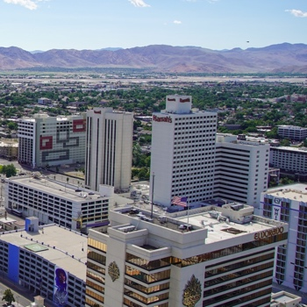











2025 Events
APHSA offers a diverse slate of conferences, events, meetings, podcasts, webinars, and on-demand webinars designed to educate and inform our members and other individuals in the human services sector. Our events showcase innovations in human services to keep you informed on what is happening in Congress and the Administration and to foster peer-to-peer engagement.
Association of Administrators of the Interstate Compact on the Placement of Children (AAICPC) Annual Business Meeting, Training Workshop
and Child Welfare Conference
APHSA
National Human Services Summit (Summit)
Economic Mobility & Well-Being (EMWB) Conference
IT Solutions Management
for Human Services (ISM) Education
Conference & Expo **
National Staff Development and Training Association (NSDTA) Education Conference
Public Human Services Attorneys (PHSA) Education Conference
May 6-7 Training
May 7-9 Business Meeting & Conference
Sheraton Denver Downtown
Denver, CO
June 1-4
Marriott Philadelphia Downtown
Philadelphia, PA
August 24-27
Hilton Minneapolis
Minneapolis, MN
September 14-17
Reno-Sparks Convention Center
Atlantis Resort
Peppermill Resort
Reno, NV
October 5-8
Sheraton Norfolk Waterside Hotel
Norfolk, VA
October 19-22
Peppermill Resort
Reno, NV
For assistance with APHSA events and conferences, please email aphsaconferences@aphsa.org.
**The sponsorship offerings in this prospectus exclude benefits for and sponsorship of the 2025 ISM Education Conference & Expo. To learn more about the ISM 2025 sponsorship opportunities, please visit https://aphsa.org/events/ism-conference/.

Slide 8
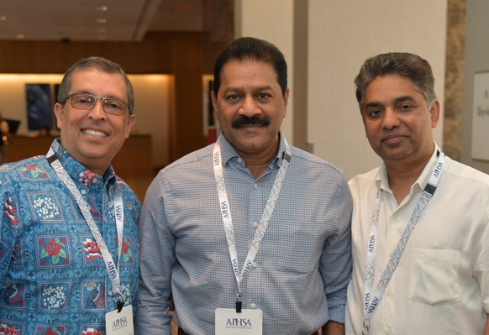
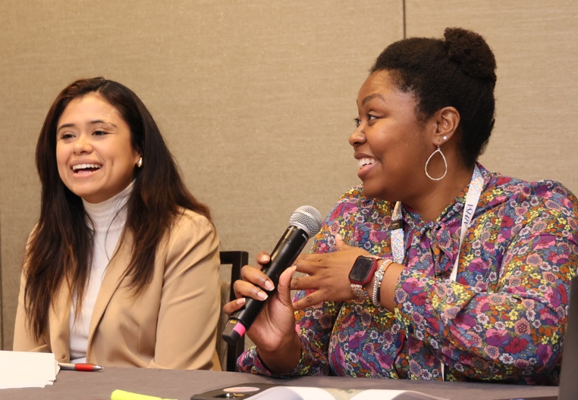

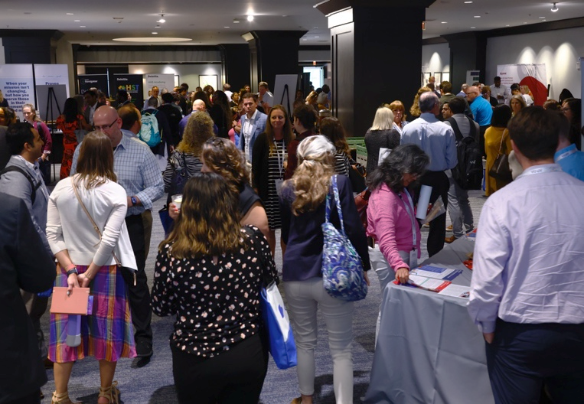


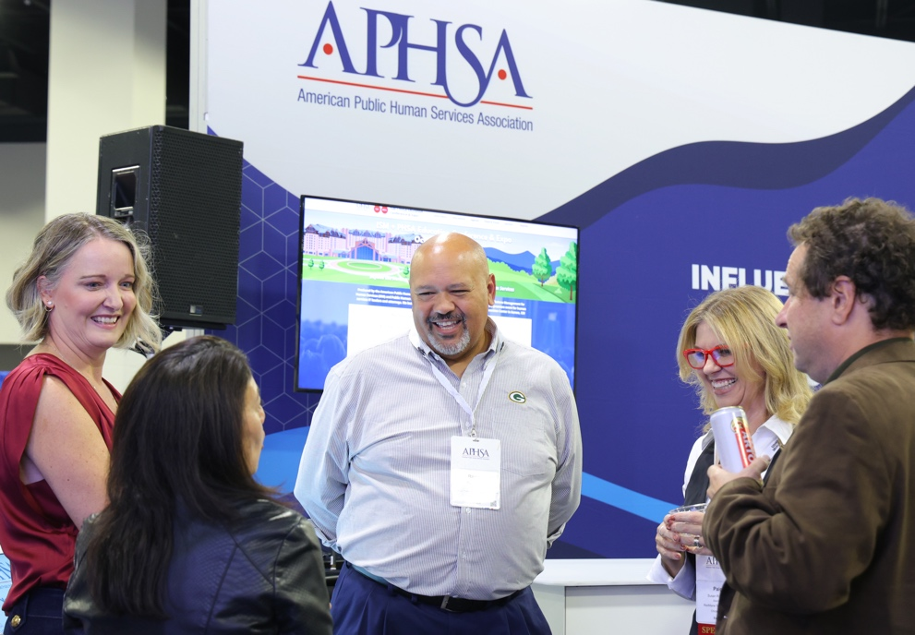
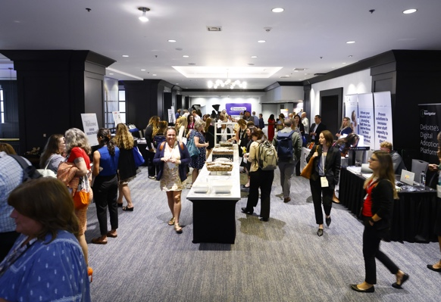

Slide 9





2025 Sponsorship Opportunities
The sponsorship offerings included underwriting experiences for four of our five educational events in 2025:
APHSA National Human Services Summit (Summit)
Economic Mobility & Well-Being Conference (EMWB)
National Staff Development and Training Association (NSDTA) Education Conference
Public Human Services Attorneys (PHSA) Education Conference
These events reach members who are in top leadership and are charged with staff training and development of the state and/or local human services agencies. Your underwriting allows the association to keep professional development reasonably priced while bringing together the top thought leaders in the sector for learning and creating memorable engagement opportunities for our members.

Slide 10


Sponsorship Levels that Suit You
Benefits | $18,750 | $11,500 | $5,000
Tabletop Exhibit¹ | Included | Included | Included
Acknowledgment – Throughout the Conference | Included | Included | Included
Recognized as a Sponsor on the Conference App | Included | Included | Included
Marketing Insert per Conference² (optional) | Included | N/A | N/A
Receipt of Attendee Lists with Contact Information | Pre- and Post-Conference | Pre- and Post-Conference | Post-Conference Only
Complimentary In-Person Registration³ | 6 | 4 | 3
Recognition on the APHSA Conference Websites | Logo with URL | Logo with URL | Company Name with Hyperlink
Choice of One (1) of the Following Additional Benefits for the Year⁴ | Meeting Room Wi-Fi Hotel Room Keycards Conference App Conference Chatbot Charging Station Journal Swag Bag | Conference Signage or Select One (1) Item for the Swag Bag: Water Bottle Hand Sanitizer 3-in-1 Charging Cable | Coffee Breaks (2 Opps) or Select One (1) Item for the Swag Bag: Snack Item (2 Opps) Scrambler/Mind Puzzle (2 Opps)
1 Tabletop is defined as one (1) skirted six-foot table or equivalent space, two (2) chairs, and access to one (1) 110 outlet. AV is additional and may be ordered directly from the AV provider.
2 Marketing insert, per conference and provided by the sponsor, should be no larger than 8.5” x 11” and weigh no more than five (5) ounces. Inserts may be non-sponsored items (postcard, flyer, etc.).
3 Complimentary registrations may be used amongst the three (3) conferences. Additional registrations will be made available at a discounted rate.
4 APHSA will assist with the customization of any co-branded items that are sponsored in a package.

Slide 11
Explanation of Benefits – Full Year Sponsors
Year-round sponsors enjoy benefits of the specific level plus additional exposure as defined as follows:
EXHIBIT SPACE (TABLETOP) –
Benefit from traffic throughout the foyer of the meeting space with a tabletop display during every conference. The exhibit includes the following:
One (1) 6 ft. table or equivalent space with two (2) chairs
One (1) 110 outlet access
One (1) tabletop sign with logo
SWAG BAG – One (1) opportunity for the year
Put your brand on the Swag Bag, an environmentally friendly reusable tote that will be filled with co-branded items and given to attendees, providing brand exposure to all who attend the event. As the sponsor of this hot item, you will receive these benefits:
Logo on the Swag Bag
MEETING ROOM WI-FI – One (1) opportunity for the year
Attendees carry an average of 2.5 electronic devices to stay connected. Sponsoring this key item, your benefits include:
Logo recognition at the conference as Wi-Fi sponsor
Your company name (or acronym) used as the login password
When possible, a custom splash page will be provided
HOTEL ROOM KEYCARDS – One (1) opportunity for the year
This opportunity reaches all conference attendees with your brand at their fingertips every time they go to their hotel room. Keys will be distributed to all registered attendees staying at the conference hotel.
CONFERENCE SIGNAGE – One (1) opportunity for the year
Attendees check out the conference signage to know where to be at any given time during the conference. Your company logo will be on all general conference signage and displayed throughout the venue.
ITEMS FOR SWAG BAG – One (1) sponsor per item; some have multiple opportunities
The Swag Bag will be provided to in-person attendees with cool swag and snacks. Production is included in the cost of the sponsorship. Based on your level of sponsorship, you may select one (1) of the following items for the swag bag:
Journal
Water Bottle
Hand Sanitizer
Snack Item, two (2) opportunities
Scrambler/Mind Puzzle, two (2) opportunities
3-in-1 Charging Cable
CHARGING STATION – One (1) opportunity for the year
This co-branded opportunity allows you to put your brand on the charging station for each conference.
Note: Sponsor provides the artwork.
COFFEE BREAKS – Two (2) opportunities per conference, one (1) per company
Coffee and snack breaks are very popular amongst attendees as they move from one session to another. Napkins with your logo and signage will be provided for the breaks.
CONFERENCE APP – One (1) opportunity for the year
The Conference App will provide the attendees with access to the schedule, speaker information, venue maps, exhibit hall information, who is attending, and other information on the event. The sponsor will receive two (2) push notifications during each conference as well as branding within the app.
CONFERENCE CHATBOT – One (1) opportunity for the year
"Ask Abby," the APHSA Chatbot, will be used by conference attendees to inquire about important logistical information about the conference (e.g., hotel, registration rates, etc.) in advance, which puts your brand in front of prospective attendees well before they are registered.

Slide 12

À La Carte Sponsorship Opportunities
Choose from the à la carte offerings to build a custom package to meet your marketing goals. These opportunities are in addition to the annual sponsorship fee.
ENGAGEMENT OPPORTUNITY –
One (1) opportunity per conference
Investment: $14,550 per reception
The Networking Receptions are premier social events at every conference. Sponsorship ensures exposure to all attendees at these networking events, and you will receive the following benefits:
“Sponsored by” signage placed at the event
Cocktail napkins with company logo
Additional branding is provided when possible
GENERAL SESSION –
One (1) opportunity per conference
Investment: $13,750 per conference
Keynote speakers set the tone or bring it all to a close for conference attendees. Underwriting the keynote speaker provides you with an opportunity to invest in the development of our members and attendees. You will also enjoy these additional benefits:
“Underwritten by” signage placed at the session
Opportunity to introduce the keynote speaker and provide a two-minute highlight of your organization
Opportunity for a personal meet and greet for you and up to 25 invited guests
CONTINENTAL BREAKFASTS –
One (1) opportunity per conference
Investment: $12,250 per conference
Kick-start the day! Breakfast is a great way to jump-start the day and open ongoing conversations with conference attendees. As a breakfast sponsor, your company will meet, greet, and network with attendees while receiving the following additional benefits:
Logo recognition at each breakfast with appropriate signage near the serving area
Logo cocktail napkins placed at the continental breakfast
HEADSHOT LOUNGE –
Up to four (4) opportunities for the year
$8,000 per conference
Interested in buying out this opportunity for 2025?
Contact Sales at anogueira@aphsa.org
Polish your professional image! We offer a professional photography studio where you can get your headshot updated and show the best possible you. You can immediately upload and send your photos to yourself via email, text, or social media. Available at National Human Services Summit Only. If a sponsor is acquired for EMWB and/or NSDTA, a headshot lounge will be provided.
MEDITATION/QUIET ROOM SPONSORSHIP –
Investment: $10,000 per conference
Sponsor our serene meditation/quiet room and offer individuals a peaceful sanctuary to relax, unwind, and find inner peace. This dedicated space will provide a tranquil escape from the fast-paced world and promote mental and emotional well-being. Join us in supporting this initiative, fostering a harmonious environment for individuals to rejuvenate their minds and improve their overall wellness.
WELLNESS CHALLENGE –
Investment: $18,000 buyout only
Conference attendees are constantly on the move, making this the perfect opportunity for your brand to stand out! Sponsor our Wellness Challenge and connect with participants as they track their activity. We will tailor the challenge to align with your marketing objectives. Your company will be featured in push notifications, encouraging attendees to join the challenge, and branded signage will be displayed throughout the event. A leaderboard highlighting the top 25 walkers will also showcase your logo. This sponsorship is a dynamic way to increase brand exposure while supporting active attendees.
MASSAGE RETREAT –
Up to Four Opportunities for the year
$8,000 per conference
Interested in buying out this opportunity for 2025?
Contact Sales at anogueira@aphsa.org
Create a serene, spa-like experience with our Massage Retreat sponsorship. Enjoy electronic foot massage stations, complimentary device charging, soothing aromatherapy, relaxing spa music, and more—designed to help attendees unwind and recharge during the conference. As a sponsor, you'll receive prominent signage to showcase your brand in this calming environment. Additionally, you have the exclusive opportunity to provide branded shirts for the massage therapists, ensuring your company is visible to attendees as they relax and enjoy the retreat.

Slide 13




Single Conference
Sponsorship Opportunities
APHSA recognizes reaching a niche or targeted market may be the driving force for your sponsorship. You can easily reach a single sector of the human services workforce by underwriting the conference that you’re directly focused on reaching. Below are the explanation of benefits and investment levels per conference.
Benefits | $6,750 | $4,750 | $3,500 | $1,850
Complimentary Full Conference Registration | 4 | 3 | 2 | 1
Discount Conference Registration for Additional Personnel | Included | Included | Included | Included
Tabletop Display | Included | Included | Included | Included
Swag Bag (selection of items provided) | One (1) Item | One (1) Item (+$1,000) | N/A | N/A
Logo Representation on Conference Website(s) | Logo with URL | Logo with URL | Company Name (Text) with URL | Company Name (Text)
Receipt of Attendee List with Contact Information | Pre- and Post-Conference | Post-Conference | Post-Conference | Post-Conference
CONFERENCE REGISTRATION – Includes full conference registration to attend all sessions and official functions.
TABLETOP DISPLAY – One (1) six-foot tabletop with two (2) chairs will be provided. Company may bring their pop-up display units if they don’t exceed 10’. Access to one (1) electrical outlet will be provided if required. Placement of tabletop displays will be in the foyer of the hotel and assigned on-site by staff.
SWAG BAG INSERT – A swag bag will be provided to attendees. A selection of options will be provided.
ATTENDEE LIST – The list will include the full contact information of opted-in attendees. The attendee list complies with GDPR guidelines. Attendees have the option to opt out of sharing this information.

Slide 14







2025 Contract & Order Form
QUESTIONS OR TO SUBMIT COMPLETED
FORMS AND PAYMENTS, PLEASE CONTACT
Exhibit and Advertising Sales Team
Anna Nogueira or Phil Galanty
American Public Human Services Association (APHSA)
1300 17th Street North, Suite 340, Arlington, VA 22209
T: (800) 856-8567 | E: anogueira@aphsa.org
All contracts must be complete, signed, and prepaid.
SPONSORSHIP OPPORTUNITIES – FULL YEAR Please indicate the additional benefit chosen:
CHAMPION $18,750
Meeting Room Wi-Fi
Hotel Room Keycards
Conference App
Conference Chatbot
Charging Station
Journal
Swag Bag
COLLABORATOR $11,500
BILLING INFORMATION If different than contact info
Name:
Title:
Address:
City, State:
ZIP: Phone:
Email:
Conference Signage
Water Bottle
Hand Sanitizer
3-in-1 Charging Cable
BENEFACTOR $5,000
Coffee Breaks (two opportunities)
Snack Items (two opportunities)
Scrambler/Mind Puzzle (two opportunities)
SPONSORSHIP OPPORTUNITIES – SINGLE CONFERENCE Please indicate level and conference(s) chosen:
SUMMIT ’25
EMWB ’25
NSDTA ’25
PHSA '25
$6,750
$4,750
+ Swag Bag Item $5,575
$3,500
$1,850
$6,750
$4,750
+ Swag Bag Item $5,575
$3,500
$1,850
$6,750
$4,750
+ Swag Bag Item $5,575
$3,500
$1,850
$
$6,750
$4,750
+ Swag Bag Item $5,575
$3,500
$1,850
ORDER TOTAL
À LA CARTE OPPORTUNITIES Please indicate à la carte opportunity and conference(s) chosen:
PAYMENT INFORMATION
Check #:
Credit Card #:
Expiration Date: /
By signing this form, you permit us to debit your account for the amount indicated. This authorization is permission for a single transaction only and does not provide for any additional unrelated debits or credits to your account.
Cardholder Name:
Cardholder Signature:
Authorized Name:
Authorized Title:
Authorized Signature:
SUMMIT ’25
EMWB ’25
NSDTA ’25
PHSA '25
Engagement Opp.
Keynote Speaker
Continental Breakfasts
Headshot Lounge
Meditation/Quiet Room
Wellness Challenge
Massage Retreat
Engagement Opp.
Keynote Speaker
Continental Breakfasts
Headshot Lounge
Meditation/Quiet Room
Wellness Challenge
Massage Retreat
MasterCard
Visa
Am. Ex.
Please Invoice
Engagement Opp.
Keynote Speaker
Continental Breakfasts
Headshot Lounge
Meditation/Quiet Room
Wellness Challenge
Massage Retreat
Engagement Opp.
Keynote Speaker
Continental Breakfasts
Headshot Lounge
Meditation/Quiet Room
Wellness Challenge
Massage Retreat
SPONSOR INFORMATION
Company/Organization:
Website:
CONTACT INFORMATION
Name:
Title:
Address:
City, State:
ZIP: Phone:
Email:
ADDITIONAL ATTENDEES
Please add the full name(s) below for allotted complimentary registration(s)

Slide 15

APHSA Event Sponsorship Opportunities 2025
For more information, please contact:
Sponsorship Sales Team
Anna Nogueira or Phil Galanty
T: (800) 856-8567 | E: anogueira@aphsa.org
Director, Membership and Events
Donna Jarvis-Miller, CMP, CEM
T: (202) 866-0569 | E: djarvis-miller@aphsa.org
American Public Human Services Association
1300 17th Street North, Suite 340, Arlington, VA 22209
www.APHSA.org
updated 2/3/2025

